Slide 1
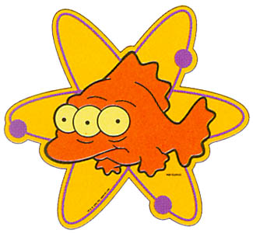
The Role of Mutation in Genetic Variation
NEXT

Slide 2
Genetic Variation
Evolution requires the presence of variation
Mutation is the source of variation
Causes include: radiation, chemicals, viruses and spontaneous mistakes in DNA replication and cell division
NEXT

Slide 3
Types of Mutations
Gene mutations
    Substitutions (Nonsense or Mis-sense)
    Deletions
    Insertions
    Can produce proteins with different function or no function that can change phenotype.
NEXT

Slide 4
Types of Mutations (continued)
Chromosomal (block) mutations – rearrangements of blocks of genes within or between chromosomes
    Deletions
    Duplication
    Translocations
    Inversions
    Can also produce variation
NEXT

Slide 5
Types of Mutations (continued)
Genomic mutations – change in the number of chromosomes. (Fewer or extra chromosome or sets of them).
  Produced by “non-disjunction” (means chromosome pairs not separating at meiosis)
NEXT

Slide 6
Results of non-disjunction
Euploid = having an exact multiple of the haploid (n) number of chromosomes (e.g. 2n = normal diploid, 3n = triploid, etc.)
Aneuploid = NOT having an exact multiple of the haploid number of chromosomes (e.g. 2n +1 or 2n – 1)
  Monosomic – having only one c/s of a pair
  Disomic – having two of a pair (normal euploid)
  Trisomic – 3 instead of two (e.g. Down Syndrome)
NEXT

Slide 7
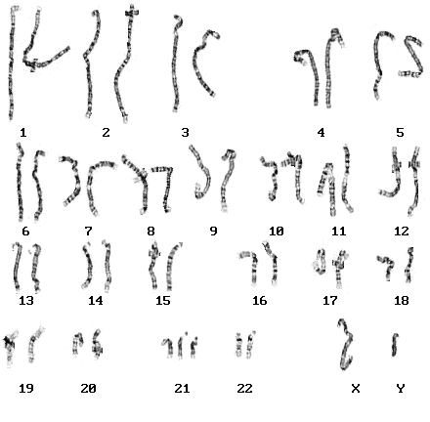
Down Syndrome – Trisomy 21
NEXT

Slide 8

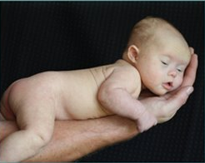
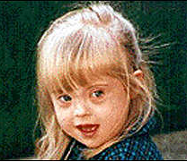
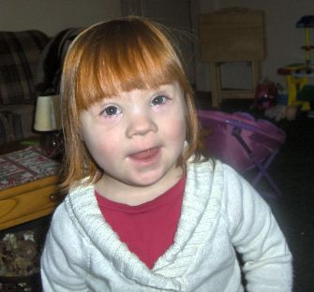
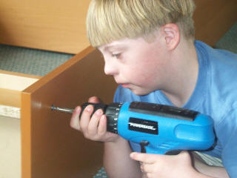
Down Syndrome
NEXT

Slide 9
NOTE
Individuals with uneven numbers or pairs of chromosomes are often infertile as meiosis requires homologous pairs to line up during metaphase.
NEXT

Slide 10
Polyploidy
= type of euploid with more than two sets of homologous chromosomes.
Polyploidy can result in instant speciation
NEXT

Slide 11
Autopolyploidy
Number of sets of chromosome increasing within a species.
1 way – non-disjunction in one parent
2N
2N
Non-disjunction
Meiosis
N
N
2N
0
gametes
Fertilisation
3N
Triploid – infertile as it doesn’t have pairs to line up in meiosis.
Can reproduce vegetatively
NEXT

Slide 12
OR
2nd way – non-disjunction in two parents
2N
2N
Meiosis
Non-disjunction
0
2N
2N
0
gametes
Fertilisation
4N
Tetraploid – fertile as it does have pairs to line up in meiosis.
NEXT

Slide 13
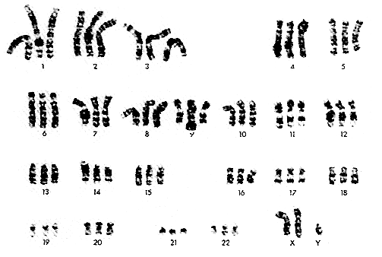
Triploid Human (don’t copy)
Although up to 2% of conceptions result in triploids, most miscarry early in development. The one below was actually born live.

Slide 14
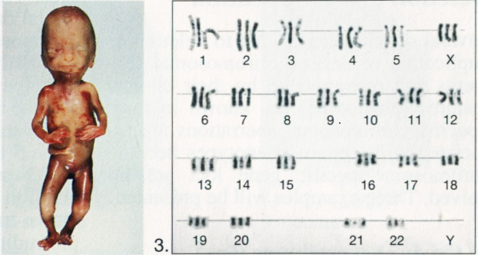
A stillborn triploid

Slide 15
Allopolyploidy
Hybridization of two different species (usually closely related) , followed by chromosome doubling.
A is one set of chromosomes from species A.
B is 1 set from species B
AA
Diploid parents
BB
Meiosis
gametes
A
A
B
B
Fertilisation
AB
Infertile hybrid – pairs don’t match. Grows vegetatively
Chromosomes double
(Amphiploidy) (often in 1st mitotic division of zygote)
AABB
Fertile polyploid – has matching pairs of chromosomes
NEXT

Slide 16
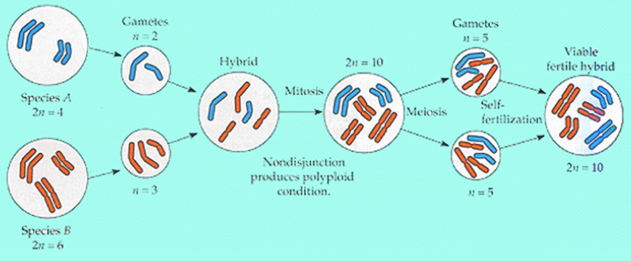
Allopolyploidy
NEXT

Slide 17
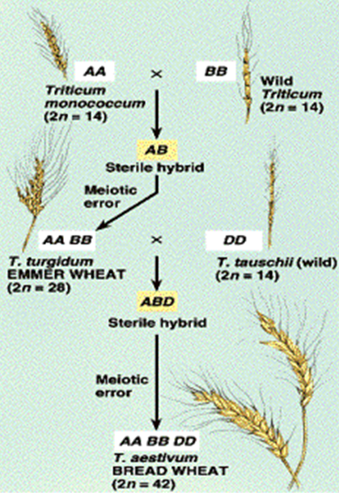
The evolution of modern bread wheat involved auto and allopolyploidy from 3 original species
NEXT

Slide 18
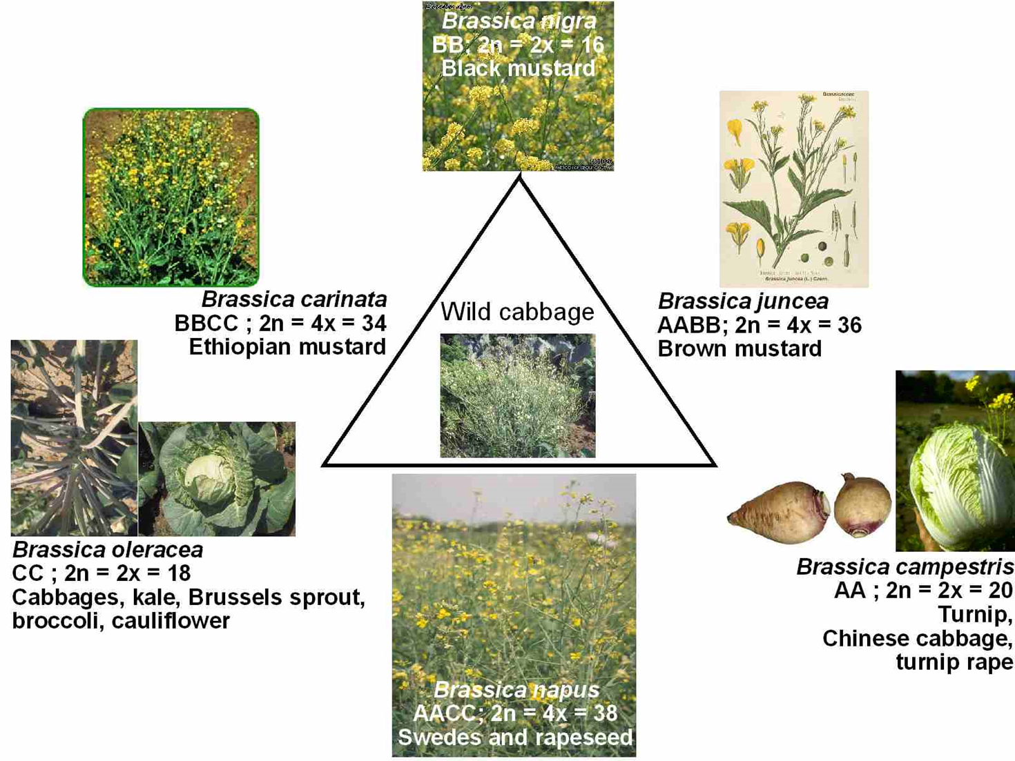
NEXT

Slide 19
Gene Flow
  Refers to migration between populations. Individuals (or pollen) may :
Emigrate (leave) – reducing genetic diversity
Immigrate (arrive) – increasing genetic diversity
Inbreeding in small populations can increase homozygosity and decrease genetic diversity
Te Mutu

